Slide 1
Edge Counter Line

Slide 2
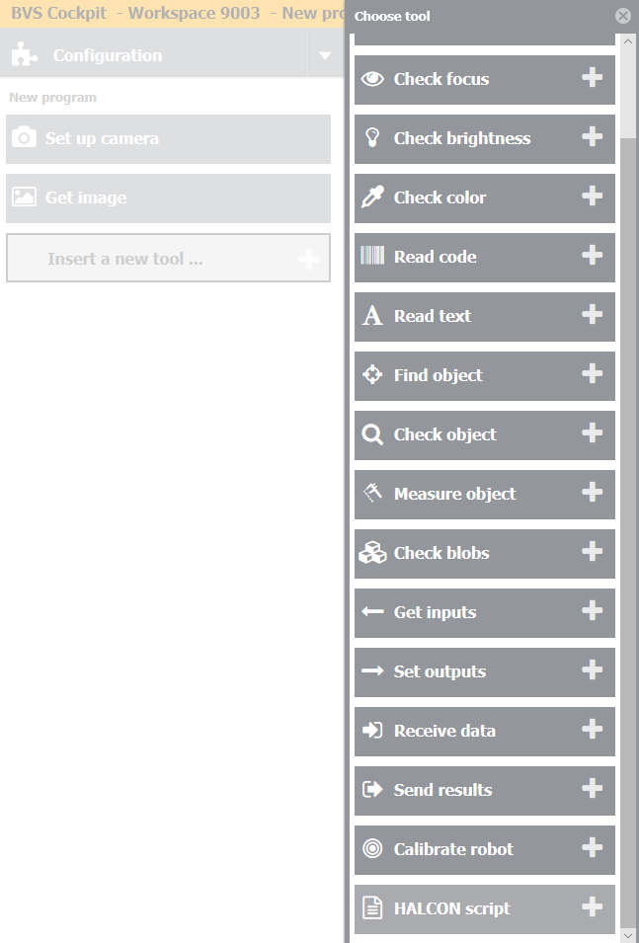
Step 1
Add new tool – Halcon Script – in your inspection program.

Slide 3
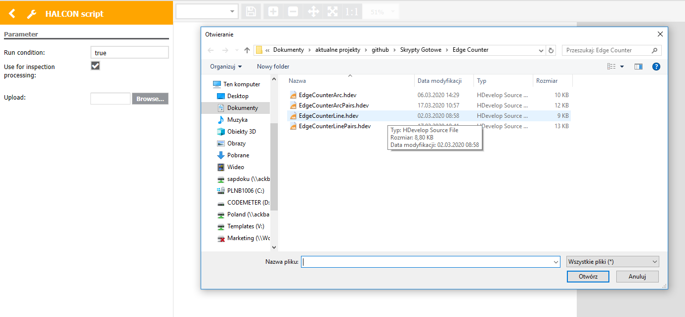
Step 2
Click „Browse” and choose „EdgeCounterLine.hdev” file.

Slide 4
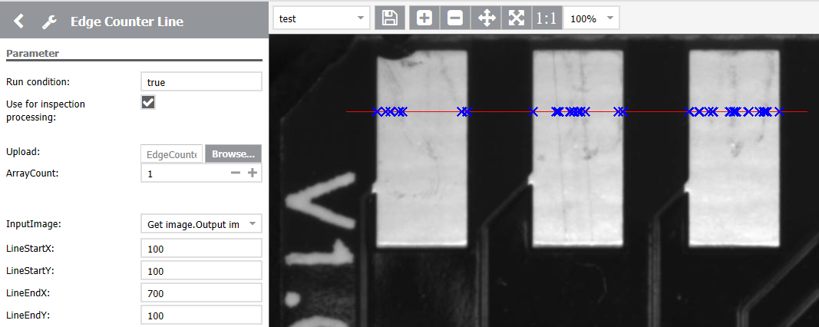
Step 3
Set the Line Start position (X and Y) and Line End position (X and Y). It will be displayed as red Line on the image.

Slide 5
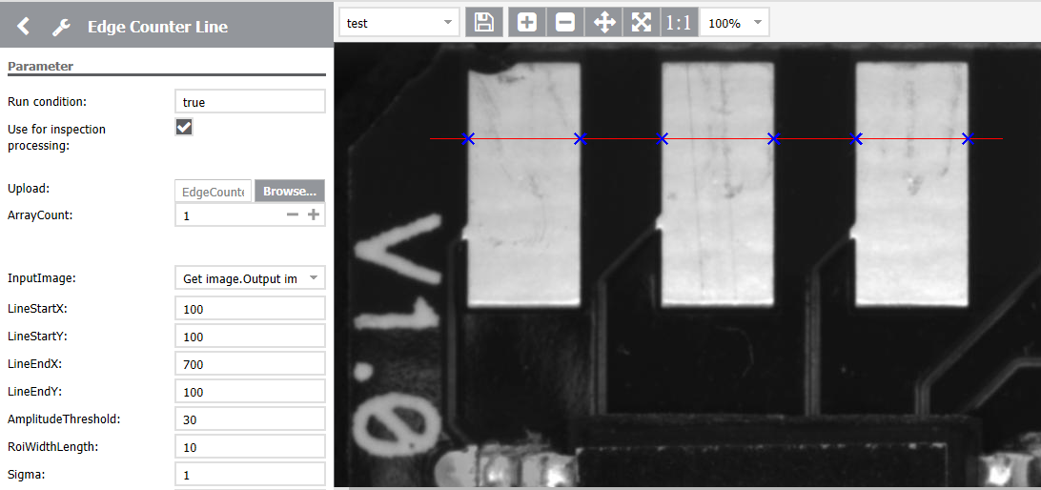
Step 3
Adjust edge parameters:
AmplitudeThreshold – minimum edge contrast
RoidWidthLength – length of the line perpendicular to the generated Line
Sigma – smoothing

Slide 6
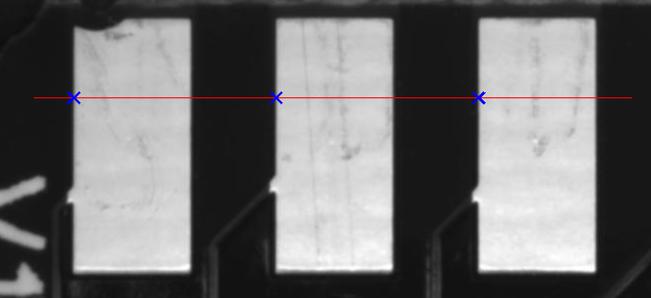
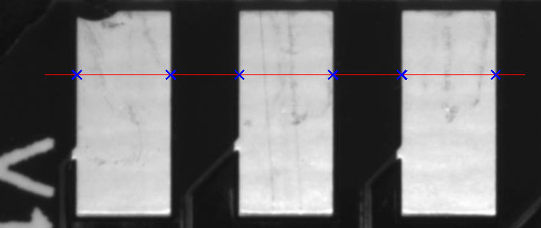
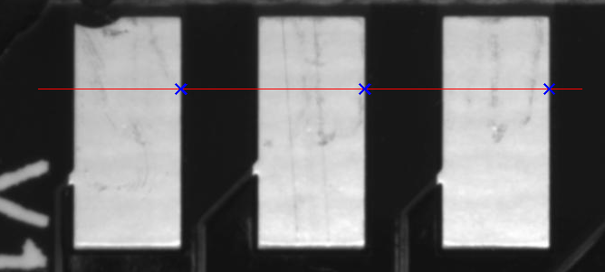
Step 4
You can also specify the edge Transition:
Positive – only edges with polarity from dark to light will be found
Negative – only edges with polarity from light to dark will be found
All – edges with both polarity will be found

Slide 7
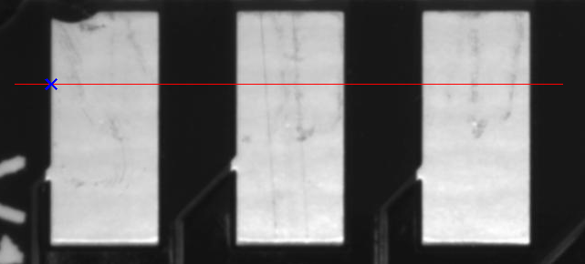
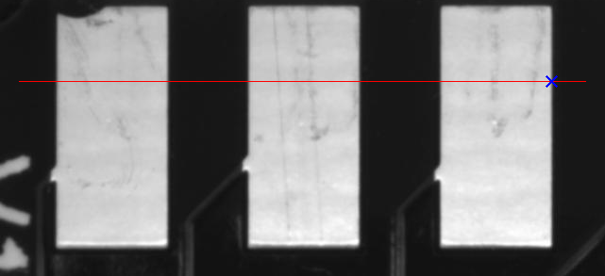
Step 5
You can also Select the edges:
First – only first edge will be found
Last – only last edge will be found
All – all of the edges will be found

Slide 8
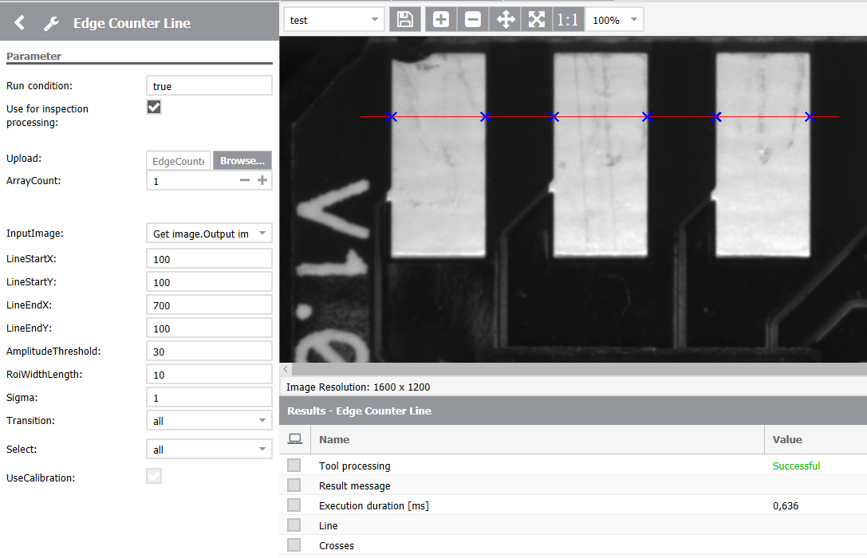
Step 6
Set the number of edges that you want to get as an output.
Found edges will be displayed as Crosses on the image.

Slide 9
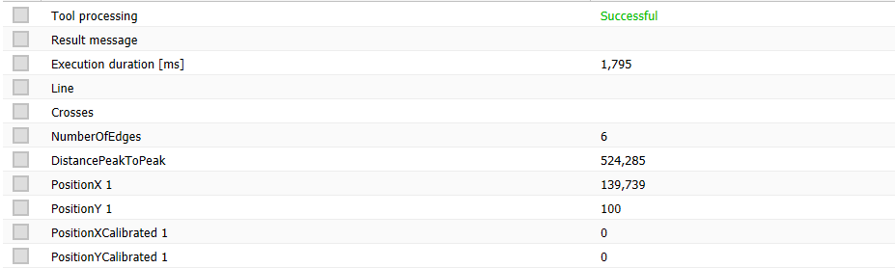
Step 7
Available output parameters:
NumberOfEdges – number of found edges
DistancePeakToPeak – distance between first and last found edge
PositionX (n) – X position of the (n) found edge
PositionY (n) – Y position of the (n) found edge
DistancePeakToPeakCalibrated – distance from first to last edge after calibration
PositionXCalibrated (n) – X position after calibration of the (n) found edge
PositionYCalibrated – Y position after calibration of the (n) found edge

Slide 10

Step 8
Calibrated output parameters have proper values if the UseCalibration variable is checked and calibration data is available.

Slide 11

Step 9
It is also possible to use locator from previous tools – in InputImage choose output image from locator tool (for example Find object tool).

